Slide 1
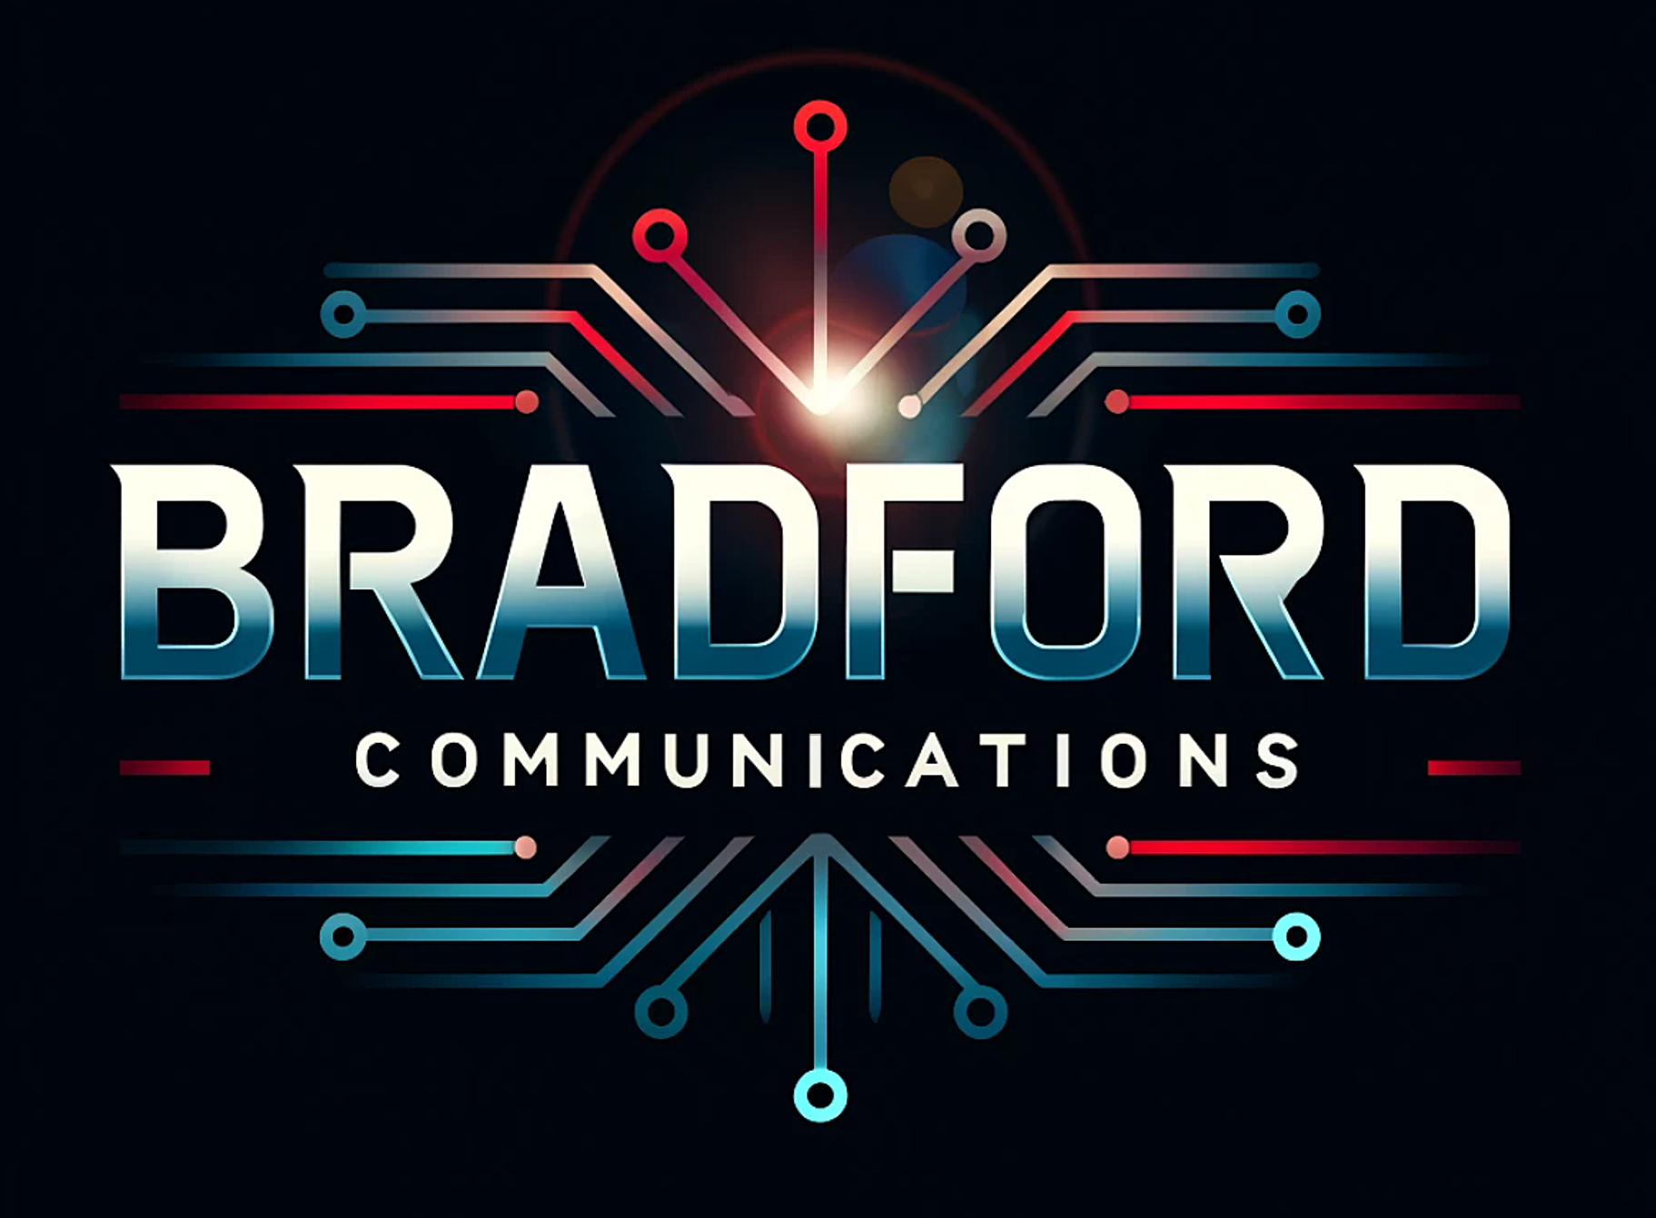
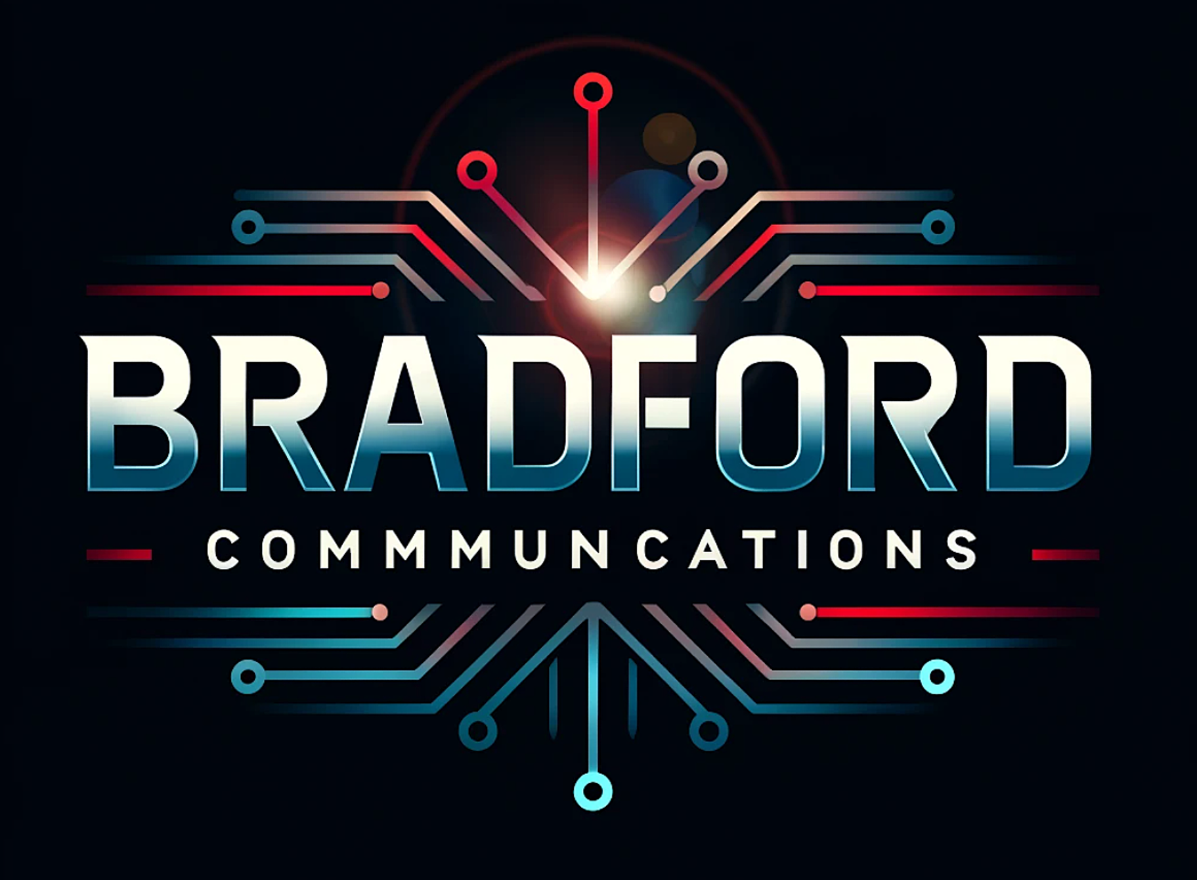
AI Images, Audio, Video Production Introduction
Bradford Communications LLC
Rick Bradford

Slide 2
Synthetic Intelligence & Human Integration
Bradford Communications LLC
Rick Bradford

Slide 3
Synthetic Intelligence & Human Integration Overview
Neural Network Architecture
OpenAI GPT, Gemini, DeepSeek, Grok
Anthropic Claude, Google Antigravity - (Vibe Coding)
Image Creation (Midjourney, GPT, Gemini)
Suno for Music, Ableton
ElevenLabs.io | Text to Speech, Speech to Text, Speech Modification, etc.
Kling, Luma Dream Machine, Sora
ClipChamp Editing
Zencastr and DistroKid Publishing
Building Your Own AI Models (Llama, Claude, Mistral & Mixtral, etc.)
Ethics, Lawful, and NDA Damage
Cybernetics, Biohacking Transhumanist Singularity (Moore’s Law, Ray Kurzweil
Sociologically Impacts, Analytical & Philosophical, Mormon Transhumanist Association (MTA)

Slide 5
Neural Network Architecture
The “Neural Network Fractal Design”
<INSERT IMAGE, ONE “POINT”>

Slide 6
Neural Network Architecture
The “Neural Network Fractal Design”
<INSERT IMAGE THAT EXPANDS INTO ONE HALF OF THE DATASET>

Slide 7
Neural Network Architecture
The “Neural Network Fractal Design”
<INSERT IMAGE THAT EXPANDS INTO THE FULL DATASET, A POINT THAT EXPANDS AND CONTRACT TO WHAT’S DESIRED>

Slide 8
Neural Network Architecture
Further Usage Of The Neural Network Fractal Design
Large Language Models are similar for text. These datasets are used to create textual responses with language resources scraped from textbooks, Wikipedia, white papers, etc.
The first note, the first voice, like the images are in Convolutional Neural Networks.
The first videos are also Convolutional Neural Networks.

Slide 10
Large Language Models (LLM)
LLM
An LLM is an advanced version of predicted text. Instead of guessing next words it can write out full sentences, answer questions and explain topics and documents, write code, and honestly have conversations.
LLM’s are trained on massive of amounts of text from books, websites and multiple other sources.

Slide 11
Large Language Models (LLM)
LLM Structures
Used to understand and generate text. Read, think, and respond.
“Think” isn’t like humans. They use patterns based on their huge input and respond with what the model considers correct.
Common uses: Chatbots, language translations, writing, coding, tutors, article summarization, and more.
Examples are ChatGPT and Google Gemini.

Slide 12
Convolutional Neural Network Models
CNN
Image, music and video production.

Slide 13
OpenAI, Gemini, Claude
Popular Artificial Intelligence Platforms
Textual
Pictures
Midjourney discussed next.
Video Production

Slide 15
Image Creation (Midjourney, GPT, Gemini)
Midjourney Website and Discord
Giving textual commands.
Style, specific camera settings, etc.
Ethical if artist names are used? Yes, or No?
Slideshows, documentation, art, and video uses.
Quick for presentations, etc.
Video creation uses.
Midjourney discussed next.

Slide 17
Suno For Music, Ableton Website
Suno Coding
<show [Intro], [Verse], [Bridge], [Outro] uses>
Suno music creation.
Genre styles
djent, instrumental, male voice, hard rock, chill step, symphonic orchestra, R&B, etc.
Editing
Clipping
Extending

Slide 19
Kling, Luma Dream Machine, <Others>
Kling
Give descriptive commands.
<show slide of the 5>
Credits
1.6 to 2.0
Microsoft Clipchamp Editing

Slide 21
Clipchamp Editing
Microsoft Clipchamp
Clip merging.
Fading between clips. Timing.
Adding Music.
Publishing

Slide 23
DistroKid Publishing
DistroKid Purpose
After you’ve created either music or videos, DistroKid can publish across several different platforms.
Cost.
How to examples.

Slide 25
NDA Damage, Ethics, and Laws
Non-Disclosure Agreements
Using NDA coding and documentation on a platform’s AI engine.
Dangerous and easily hackable as LLM’s evolve.
Researching private and company information in a public, non-encapsulated AI environment.
Educating what to ask and what not to ask is essential, needed, and required.

Slide 26
NDA Damage, Ethics, and Laws
Ethics In AI Usage
Conflicts In Art, Music, Videos and Schools
Artist’s and musician’s work being used in CNN (Convolutional Neural Networks) models to use physical work to create AI similarities.
Is using AI to create your own work ethical if you use the CNN’s made from other people’s work?
School dishonesty is obvious for long term AI users who train forgery algorithms to detect it.
When students use AI for cheating, is AI a modern type of calculator, or are students shortcutting around fundamentals they should know? Your opinions and suggestions matter.

Slide 27
NDA Damage, Ethics, and Laws
AI Laws and Testing In Utah
Quote the innovate (us) article.
Google Gemini was chosen in an encapsulated environment with 257 testers in 2024.
Utah DTS is a stakeholder division who develops software for BLS and DOL.
Why and how is it privately encapsulated with government and corporations?
How are the LLM and CNN fed data? Guess.
How is the data collected and recycled through these private models?

Slide 28
Questions?
Bradford Communications LLC
Rick Bradford

Slide 29
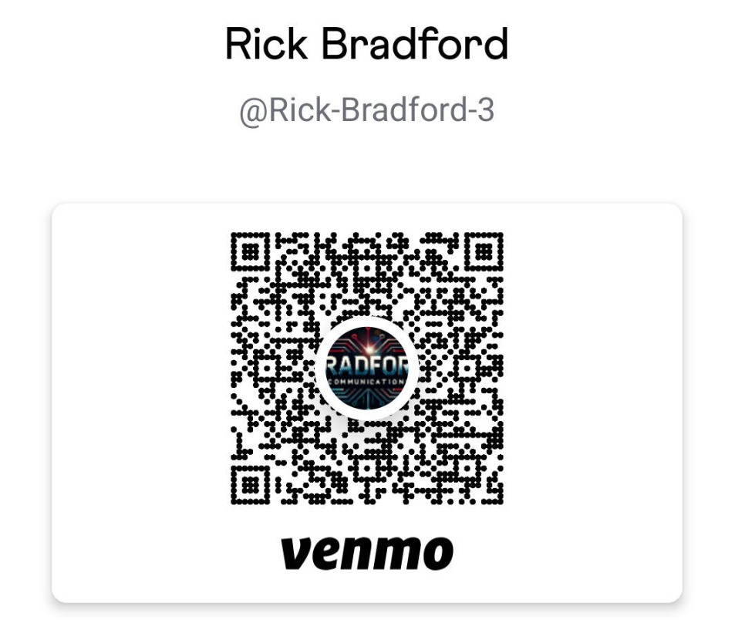
Charitable Donations Accepted to Grow My Business Further

